Slide 1
An Introduction to Deep Learning
Yalong Jiang
Department of Electronic and Information Engineering
the Hong Kong Polytechnic University
yalong.jiang@connect.polyu.hk

Slide 2
Catalogue
Introduction
Basic Tools
Software platform-Based on HPC GPU Cluster
Parallel Operations (MPI)
Example

Slide 3
Introduction

Slide 4
Introduction
Necessary skills:
1. Describe our problems and reformulate the solution to a mapping. (A neural network is a mapping)
2. Building basic blocks and survey of available solutions.
3. Setting up networks or frameworks with proper loss functions.

Slide 5
Basic Tools
Ubuntu
CUDA
Python (No matter what software platform)

Slide 6
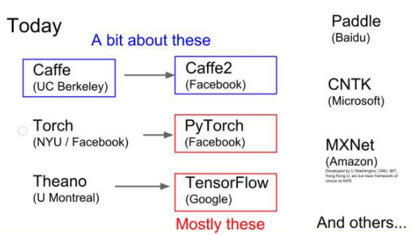
Software platform-HPC GPU Cluster

Slide 7
Software platform-HPC GPU Cluster
Caffe (Together with Pytorch) and Tensorflow
Advantages of caffe:
1. Easy to use.
2. Comprehensive open-source code covering recognition, tracking and detection. (Model Zoo)
3. Suitable for research in CV, HPC and Numerical Optimization.

Slide 8
Software platform-HPC GPU Cluster
4. Available interfaces in python and matlab (All the components in caffe can be re-written with python)
5. Suitable for production deployment.

Slide 9
Software platform-HPC GPU Cluster
Advantages of Tensorflow:
Large community.
Stable.

Slide 10
Software platform
Installation of caffe
1. Installation of Ubuntu
2. NVIDIA Driver
3. (Optional) Matlab
4. Basic libraries
5. GCC compiler
6. CUDA & CUDNN
7. Intel MKL
8. OpenCV
9. Anaconda (Python)

Slide 11
Software platform
1. Installation of Ubuntu
https://www.ubuntu.com/download/desktop
Dual system (Together with Windows):
http://www.jianshu.com/p/1ef7d055a3f9
http://blog.csdn.net/zwyjg/article/details/16371349

Slide 12
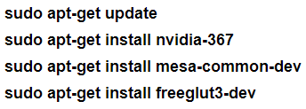
Software platform
2. NVIDIA Driver
Install with commands

Slide 13
Software platform
Installation of Matlab (Optional)
Pre-install of java
Acquire licence
Run matlab:
cd /usr/lib/jvm
sudo sh /path/to/MATLAB/R2015b/bin/matlab

Slide 14
Software platform
Installation of Basic Libraries
build-essential libprotobuf-dev libleveldb-dev libsnappy-dev libopencv-dev libboost-all-dev libhdf5-serial-dev libgflags-dev libgoogle-glog-dev liblmdb-dev protobuf-compiler
Usage of protobuf:
Defines the organization of data:

Slide 15
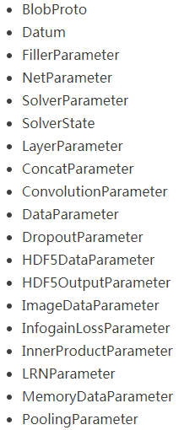
Software platform

Slide 16
Software platform
Problems with protobuf:
Common ways of installing protobuf is through:
sudo apt-get install python-protobuf
However, the newest version is not compatible with current software platforms.
Solution:
Download version 2.5.0: https://github.com/google/protobuf/releases/tag/v2.5.0
Install
Check with
protoc --version

Slide 17
Software platform
Usage of lmdb and hdf5:
1. Reasons to use HDF5:
Simple format to read/write.
2. Reasons to use LMDB:
LMDB uses memory-mapped files, giving much better I/O performance.
Works well with really large datasets.
You can easily split your data into several HDF5 files though (just put several paths to h5 files in your text file).

Slide 18
Software platform
Installation of GCC Compiler
For Ubuntu 16.04, it is better to upgrade gcc to 5+ version.

Slide 19
Software platform
Installation of CUDA
1. Shutdown lightdm: sudo service lightdm stop
2. Down packages (.deb is better than .run):
https://developer.nvidia.com/cuda-downloads

Slide 20
Software platform
Installation of CUDNN:
Acceleration of the computation of convolutional and pooling layers.

Slide 21
Software platform
Setting environment variables:
Install CUDA Sample:

Slide 22
Software platform
Installation of Intel MKL:
Optimization on math functions.

Slide 23
Software platform
Installation of OpenCV
https://github.com/bearpaw/Install-OpenCV
Suggested version: 2.4.10

Slide 24
Software platform
Installation of Anaconda:
Mange python packages of different versions.
https://www.continuum.io/downloads

Slide 25
Parallel Operations
Install Openmp
CAFFE_USE_MPI=${1:-OFF}CAFFE_MPI_PREFIX=${MPI_PREFIX:-""}

Slide 26
Example
Model Zoo:
https://github.com/BVLC/caffe/wiki/Model-Zoo
Example of VGG:

Slide 27
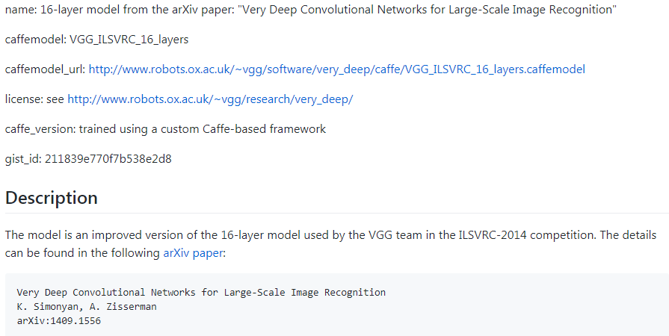
Example

Slide 28
Example
train_val.prototxt
deploy.prototxt
Generation of lmdb files:

Slide 29
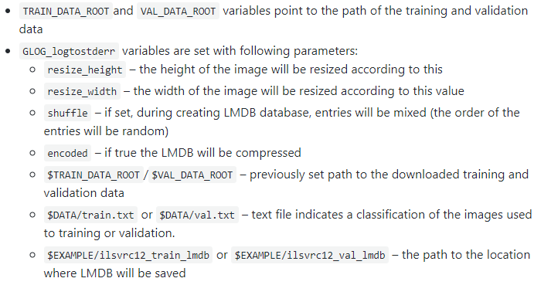
Example

Slide 30
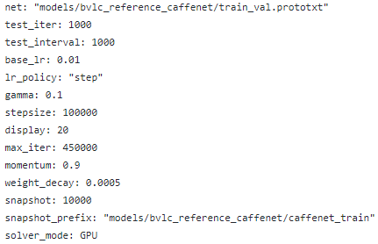
Example
solver.prototxt

Slide 31
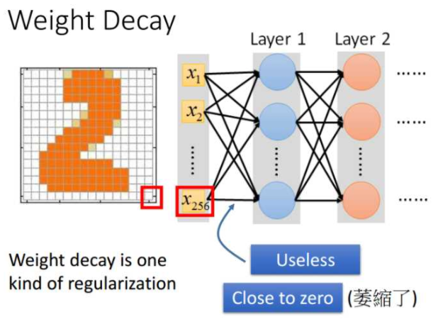
Example
Weight decay:
Weight decay is equivalent to L2 regularizer.

Slide 32
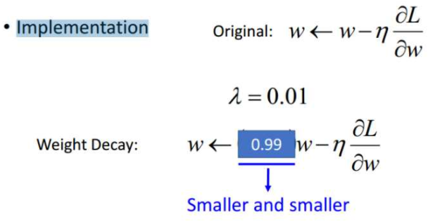
Example

Slide 33
Example
Momentum:
Momentum can be used to avoiding stuck at saddle point. The aim of optimization is to converge to the local minima, and when the network goes deeper, most of the local minima performs nearly the same.

Slide 34
Example
Training:

